Slide 1
MANAGEMENT
Dr. Sandip Mandal

Slide 2
MANAGEMENT
“Management as a discipline has attracted the attention of academicians and practitioners to a very great extent.”

Slide 3
MANAGEMENT
Management as a discipline has drawn concepts and principles from Economics, Sociology, Psychology, Anthropology, History, Statistics and so on.
Definitions
According to Harold Koontz Management is the art of getting things done through and with the people in formally organized groups.
According to Dalton E McFarland Management is defined for conceptual, theoretical, and analytical purposes as that process by which managers create, direct, maintain, and operate purposive organization through systematic, coordinated, co-operative human effort.

Slide 4
Need For Management
Society has large and complex institutions with many people working together .
The relationship between managers and managed has changed as compared to the older master-servant relation ship making it more complex
People have greater expectations from their jobs.
“In order to make all these things function properly, people have been trying to evolve some methods and techniques. Such attempts have given the birth of management as a separate discipline”

Slide 5
Management Functions
“Management process suggests that all the managers in the organization should perform certain functions to get things done by others”

Slide 6
Management Functions
Forecasting
Planning
Organizing
Staffing
Directing
Coordinating
Controlling
Decision making

Slide 7
Management Functions
Forecasting: It is necessary preliminary to planning. Forecasting estimates what should be done in future. Forecasting begins with sales forecast, and is followed by production forecast and forecasts for costs finance, purchase, profit/loss etc.
Planning: It is the conscious determination of the future course of action to achieve the desired results. What to achieve ?, When to achieve ?, How to achieve ?. It includes determination of objectives, setting rules and procedures, determining projects, setting policies and strategies, budgeting etc.
Organizing: it is the process of dividing work in to convenient tasks or duties, grouping of such duties in the form of positions, and grouping of various positions in to departments and sections and delegating authority to each position so that the work is carried out as planned.
Staffing: Here the Managers/ HR department select train place promote and (retire) qualified people. It is a continuous process.

Slide 8
Management Functions
Directing: When people are available in the organization, they must know what they are expected to do in the organization. Superior managers fulfill this requirement by communicating to subordinates about their expected behavior. Through directing the actual performance of a subordinate is guided towards company objectives.
Directing includes,
1. Giving instructions to subordinates
2.Guiding the subordinates to do the work
3.Supervising the subordinates to make certain that the work done by them is as per the plans established.
Directing involves the following functions,
a) Leadership
b) Communication
c) Motivation
d) Supervision

Slide 9
Management Functions
Leadership: It is the quality of the behavior of a person by which he can inspire confidence and trust in his subordinates, get maximum cooperation from them and guide their activities in organized effort.
Communication: Communication is the process by which ideas are transmitted, received and understood by others for the purpose of achieving desired results. Communication may be verbal or written.
Motivation : Inspiring the subordinates to do a work or to achieve company objectives effectively or efficiently.
Supervision : Supervision is necessary in order to ensure,
1. That the work is going on as per the plan established
2. That the workers are doing as they were directed

Slide 10
Management Functions
Coordinating: Means achieving harmony of individual effort towards the accomplishment of company objectives. Make plans to regulate the activities and communication of subordinates on the job. Informal relationships within the organization always tend to facilitate coordination
Controlling : Controlling involves identification of actual results, comparison of actual results with expected results as set by planning process , identification of deviation between the two, if any and taking of corrective action so that actual results match with expected results.
1.Set standards
2.Measure Job performance
3.Take corrective action

Slide 11
Management Functions
Decision Making : It is the process by which a course of action is consciously chosen from a available alternatives for the purpose of achieving desired results.
An out standing quality of a successful manager is his ability to make sound and logical decisions.

Slide 12
Span Of Control
Span refers to the number of subordinates a manager or supervisor can supervise, manage or control effectively and efficiently

Slide 13
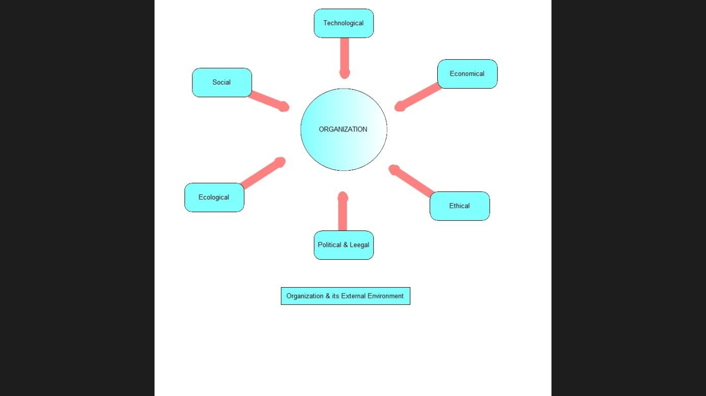
Organization & External Environment

Slide 14
Organization & External Environment
Pluralistic Society : Many Stake holders with different goals
Various groups keep business power in balance
Business interests can be expressed by joining groups (Eg. Chamber of commerce)
Business can participate in projects with other responsible groups for the betterment of society.
There can be conflict as well as agreement among groups
One group will be aware of other group’s activities

Slide 15
Organization & External Environment
Technological & Innovative Environment
Technique : The way of doing things - The vast store of organized knowledge
Innovation : finding new products, services, processes, ideas or combining
Product innovation: Apple phone
Service innovation: Apple’s Tunes
Process innovation: Toyota cars
Incremental innovation: Here we use existing knowledge or method and through continuous changes improve products/services. Disruptive/ Breakthrough innovation: They may use new methods, materials, products or services. Eg. Digital imaging

Slide 16
Organization & External Environment
Ecological Environment
Ecology means the relationship of people and other living things with their environment such as soil, water and air. These may get polluted by means of industrial waste.
Eg. in 1984 lethal vapors from Union carbide’s pesticide plant in India killed over 2000 people and injured nearly 40,000.
ISO 14001

Slide 17
Organization & External Environment
Social Environment:
There are many stakeholders and claimants to the organization. The social responsibility is associated with not only business, but with governments, universities, nonprofit foundations charitable organizations, …etc.
Sudha Moorthy, w/o Narayana Moorthy, CEO Infosys has arranged to give Library facility and Computers for Govt. Schools in Karnataka

Slide 18
Organization & External Environment
Ethical Environment :
Managerial ethics is the rules and principles, decided by upper management, that spell out what is right and wrong in an organization. Managers aim to maximize profit within the confines of ethical values and principles. They conform to professional and legal standards of conduct.
Whistle bowling: “An employee refuses to engage in and or reports illegal or wrongful activities of his employer or fellow employees”

Slide 19
Organization & External Environment
The economic environment :
consists of external factors in a business market and the broader economy that can influence a business
microeconomic environment- affects business decision making - such as individual actions of firms and consumers Eg. Demand, Supply , Competitors, Distribution chain,
macroeconomic environment- affects an entire economy and all of its participants Eg.Interest rate, tax rate, inflation…etc

Slide 20
Organization & External Environment
Political & Legal Environment:
Internal political risks include corruption, weak rule of law, social fragmentation etc.
External political risks concern inter-governmental relations and include benefits like trade agreements and investments as also the risks such as disputes that affect trans-border trade and business.
The national legal system provides the substantive law and court structure which most directly affect businesses.
MNEs operating in different countries are subject to the national law in each

